Slide 1

GLT1031 Basic Japanese Languge 1
日本語

Slide 2
INTRODUCTION
Name that you want everyone to call you.
Which Faculty? Your major?
Hobby/Interest?
Why you choose Japanese Language elective?
Do you have any basic Japanese Language?
Extra information that you want to share with everyone!

Slide 3
97ujcf

Slide 4
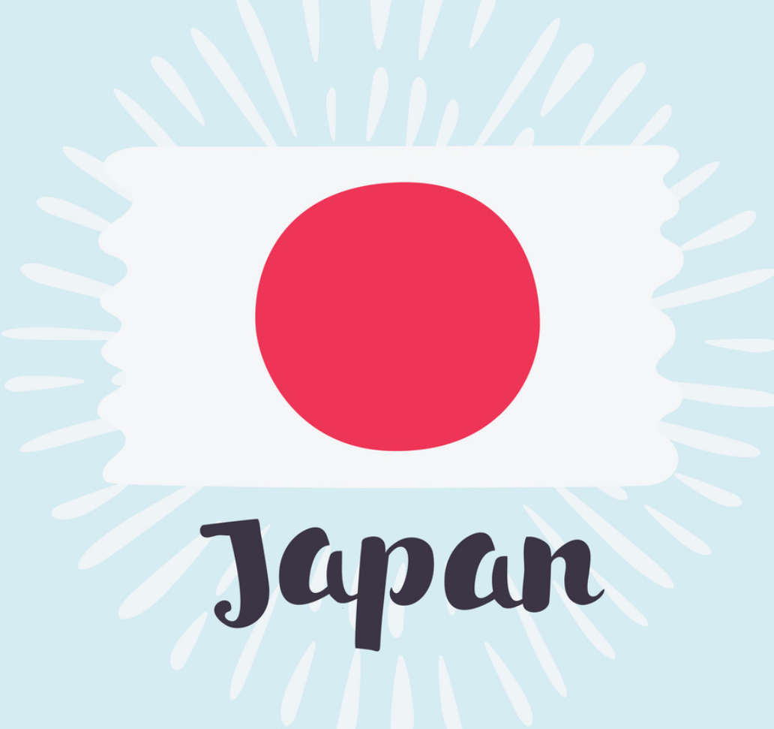

Slide 5
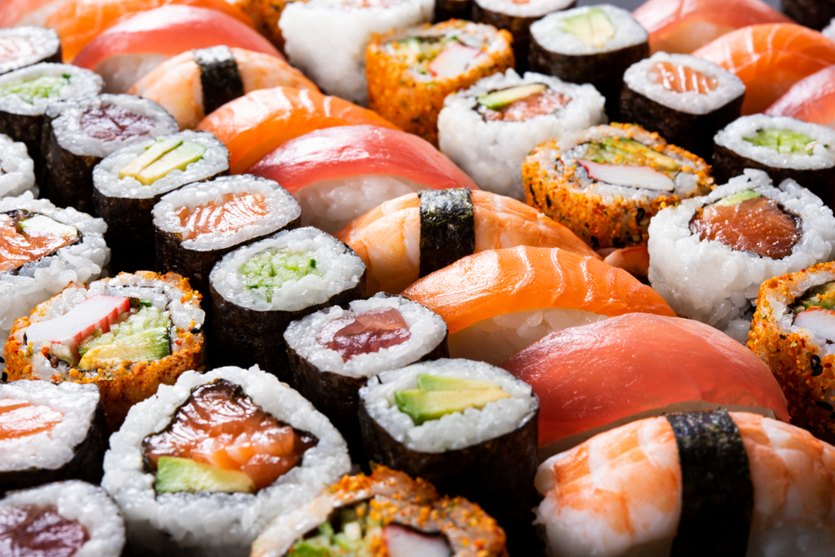
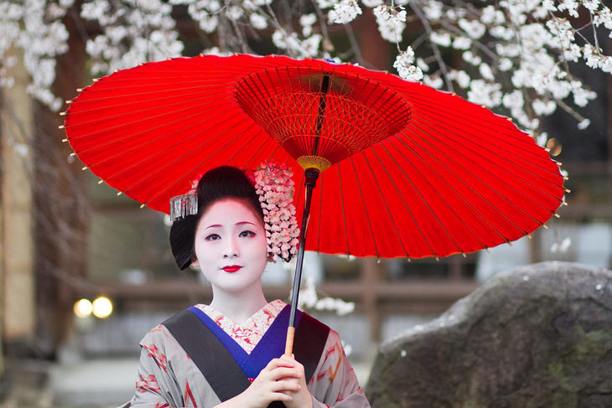
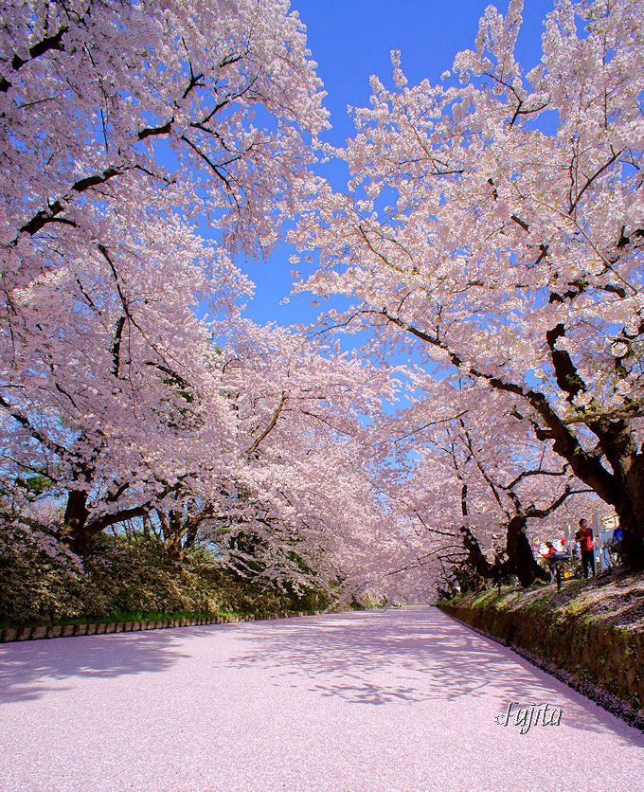
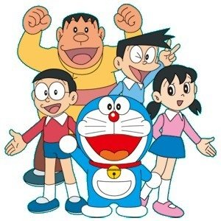


Slide 6
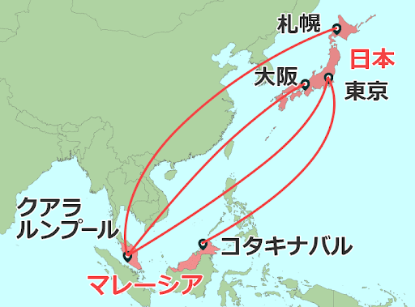

Slide 7
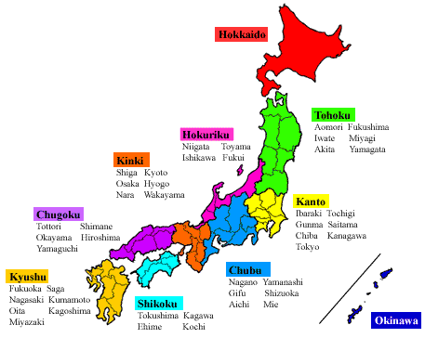

Slide 8
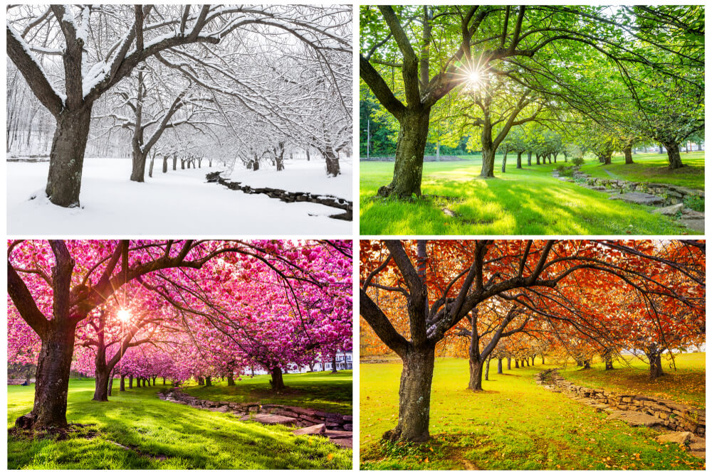

Slide 9

Introduction to Japanese Language
✅ Pronunciation
✅ Sentence structure
✅ Japanese writing system

Slide 10
Pronunciation
Have 5 vowels （あ-a、い-i、う-u、え-e、お-o)
Similar to Malay Language
  Consonant + Vowel Example the sound of “ka” from “kaki” : k+a = ka
Each word can start with vowel or consonant, but must end with vowel
  (except ん-n sound). Example : ほん(hon) = bag
Vowels to be dropped
  すきです (sukidesu) = I like
  たべます (tabemasu) = to eat
Long vowels & Short vowels

Slide 11



Slide 12


Let’s listen again
obasan (aunt) ー obaasan (grandmother)
ojiisan (grandfather) ー ojisan (uncle)
shujin (husband) ー shuujin (prisoner)
oya (parent) ー ooya (landlord)
seeki (century) ー seki (seat)

Slide 13
When the same vowel is placed one right after the other, the pronunciation of the vowel becomes about twice as long as the single vowel. Be sure to hold the sound long enough, because the length of the vowel can change one word to another.
aa obaasan (grandmother) obasan (aunt)
ii ojiisan (grandfather) ojisan (uncle)
uu sｈuujiｎ (prisoner) shujin (husband)
ee seeki (century) seki (seat)
oo ooya (landlord) oya (parent)

Slide 14
おはよう
o ha yo u → yoo
えいが
e i ga → ee

Slide 15
Sentence Structure
I
TV
watch
watashi
wa
terebi
o
mimasu
S
O
V
ubject
bject
erb

Slide 16
Sentence Structure
Japanese sentences are structured around grammatical markers called “particles”. Each particle indicates how the word relate to each other.
watashi
wa
terebi
o
mimasu
Particles/助詞（じょし）

Slide 17
Japanese Writing System
ひらがな
カタカナ
漢字
Hiragana
Katakana
Kanji

Slide 18
Japanese Writing System
ひらがな
Explain the grammar part
カタカナ
Foreign words
漢字
Meaning of the words

Slide 19
ひらがな
HIRAGANA

Slide 20
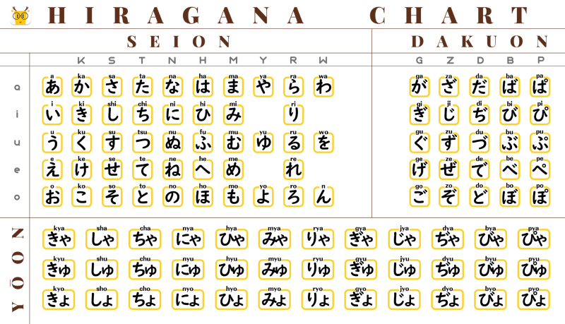

Slide 22
きゃ
き＋small や ki ya kya

Slide 23
カタカナ
KATAKANA

Slide 24
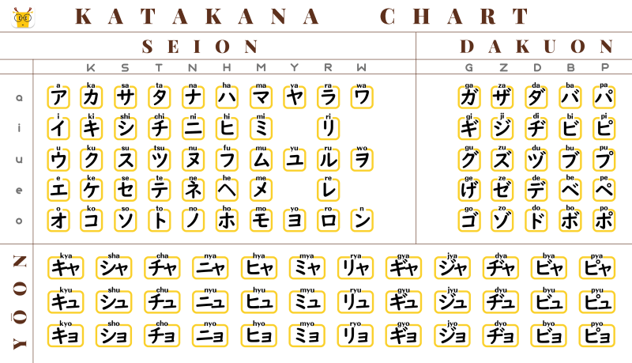

Slide 25
漢字
KANJI

Slide 26
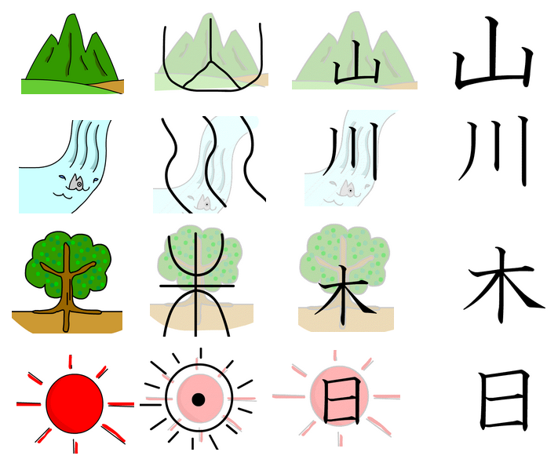

Slide 27
Japanese Writing System
私 は テレビ を 見ます
Watashi
わたし
wa
terebi
o
Mimas
みます

Slide 28

Today’s
Reflection
OCC 1
https://padlet.com/hnnhmdn/glt1031-occ-1-jnti17s92ni7jikn
OCC 2
https://padlet.com/hnnhmdn/glt1031-occ-2-d7ml4esd2f9gpqx5
OCC 3
https://padlet.com/hnnhmdn/glt1031-occ-3-o3omfw89eupzl2bx
OCC 4
https://padlet.com/hnnhmdn/glt1031-occ-4-84bzjh0qgvtff2q7

